Slide 1

Principles of exercise
PT7003

Slide 2
Principles of training
Principles of Training
Adaptation
Accommodation
Specificity
Overload
Progression
Individualisation

Slide 3
SPECIFIC
When a structure is subjected to stresses of varying intensities, it will gradually adapt, over time, to the demands placed on it
ADAPTATIONS
SAID
IMPOSE
DEMANDS

Slide 4
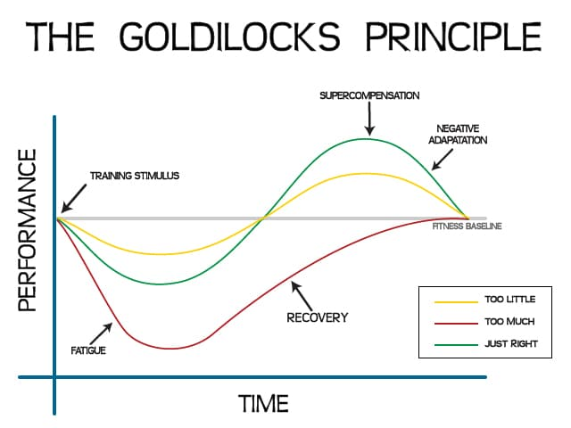
LOAD MANAGEMENT

Slide 5

PRO/REGRESSIONS
SLOW
FAST
CONTROLLED
UNCONTROLLED
KNOWN
UNKNOWN
SMALL ROM
LARGE ROM

Slide 6
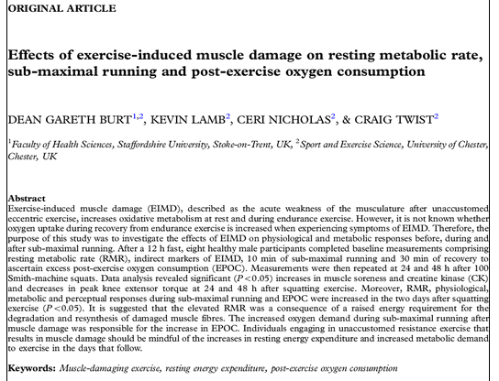
EFFECTS OF TRAINING
Acute

Slide 7
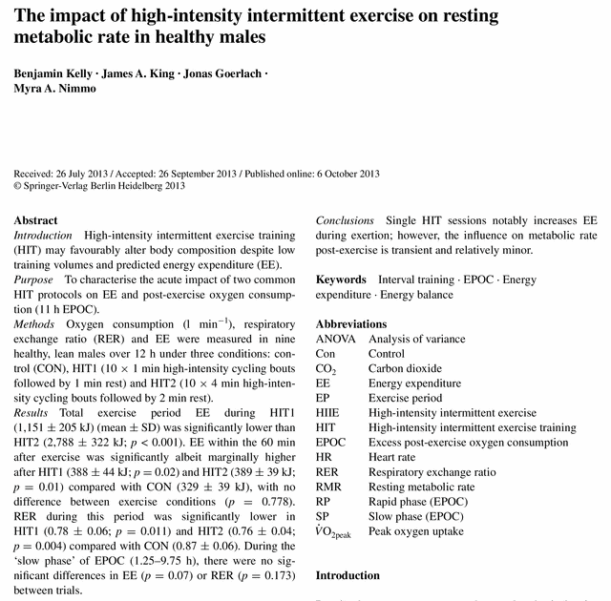

Slide 8
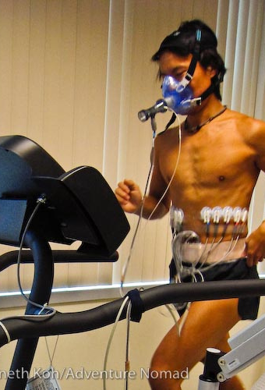
EFFECTS OF TRAINING
Chronic
Chronic adaptations to progressive workloads:
  lowered heart rate (resting and submaximal) [Bradycardia]
  Increased maximum oxygen uptake (VO_{2max})
  Increased strength

Slide 9
The Planning Process
Needs Analysis
Exercise Selection
Training Frequency
Exercise Order
Training Load and Repetitions
Rest Periods
Volume

Slide 10
Needs Analysis
Sport Assessment
Movement
Physiology
Athlete Assessment
Testing Battery
Personal Goals
Time Motion
Injuries
Previous Injuries

Slide 11
TRAINING VARIABLES
FREQUENCY – How often?
INTENSITY – How hard?
VOLUME – How much?
TYPE – What?

Slide 12
FREQUENCY
How many times per day / week
Some considerations;
    Type of training e.g. aerobic / anaerobic / resistance.
    Goals (short and long-term).
    Time in the season
    Consideration of recovery
INTENSITY
Use percentage of maximum / work level at given moment
  % of 1RM in resistance training
  % of HR Max in aerobic training
VOLUME
The amount of work (cumulative)

Slide 13
Within-session variables
Density relates to the amount of rest between work bouts in resistance training or interval training (aerobic / anaerobic)
  Inter-set rest period
  Work : Rest ratio
  What are we influencing by manipulating density?
Manipulating density has a significant impact on the hormonal and metabolic response as well as the type of muscle fibres used - therefore influencing training adaptations

Slide 14
Specificity
Resistance vs Power Training
Eg. Powerlifting vs Weightlifting
Speed & Agility Training
Eg. Accelerations or Change of Directions
Plyometric Training
Eg. Tendon Stiffness, Reactive Strength
Metabolic Conditioning
Eg. Aerobic/Anaerobic Capacity
Corrective Exercise
Eg. Movement correction, Posture

Slide 15
Basic training principles:
SPECIFICITY
Metabolic specificity: the primary energy system to be used and the fibre types targeted.
Neuromuscular specificity : specific muscle groups and patterns of movement (contractions).

Slide 16
Basic training principles:
OVERLOAD
A progressive heightening of the stressor to stimulate adaptation at a higher level
Adaptation occurs in many systems including the muscular and skeletal systems, the cardiovascular system, and the nervous system
You are aiming to create a higher potential for “activity” within cells/ tissues, so that the body can cope with higher exercise demands

Slide 17
OVERLOAD
Training load of a given exercise session can be objectively evaluated by considering several quantifiable within-session variables e.g., RPE
The intensity or volume of the work must be more than the current level in order to achieve overload and therefore physiological adaptations
Any of the FIVT principle factors can be modified to produce overload
  Frequency Intensity Volume Type

Slide 18
Training load monitoring
Week | Day | RPE | Duration | TL
6 | Monday | 2 | 50 | 100
 | Tuesday | 3 | 90 | 270
 | Wednesday | 5 | 30 | 150 |  | SD | 152.2
 | Thursday | 5 | 100 | 500 |  | Total TL | 1707.0
 | Friday | 2 | 50 | 100 |  | Average TL | 243.9
 | Saturday | 10 | 20 | 200 |  | Monotony | 1.6
 | Sunday | 9 | 43 | 387 |  | Training stress | 2735.8
7 | Monday | 5 | 35 | 175
 | Tuesday | 5 | 30 | 0
 | Wednesday | 5 | 100 | 500 |  | SD | 172.8
 | Thursday | 2 | 50 | 100 |  | Total TL | 1010.0
 | Friday | 2 | 30 | 60 |  | Average TL | 144.3
 | Saturday | 5 | 35 | 175 |  | Monotony | 0.8
 | Sunday | 0 | 0 | 0 |  | Training stress | 843.4
8 | Monday | 5 | 30 | 150
 | Tuesday | 5 | 100 | 500
 | Wednesday | 2 | 50 | 100 |  | SD | 148.1
 | Thursday | 3 | 90 | 270 |  | Total TL | 1755.5
 | Friday | 2 | 50 | 100 |  | Average TL | 250.8
 | Saturday | 3 | 90 | 270 |  | Monotony | 1.7
 | Sunday | 8.5 | 43 | 365.5 |  | Training strain | 2972.3
Valid and reliable method of measuring training load (Wallace et al, 2009)
Easy and practical
Incorporates all forms of training into one type of measure

Slide 19
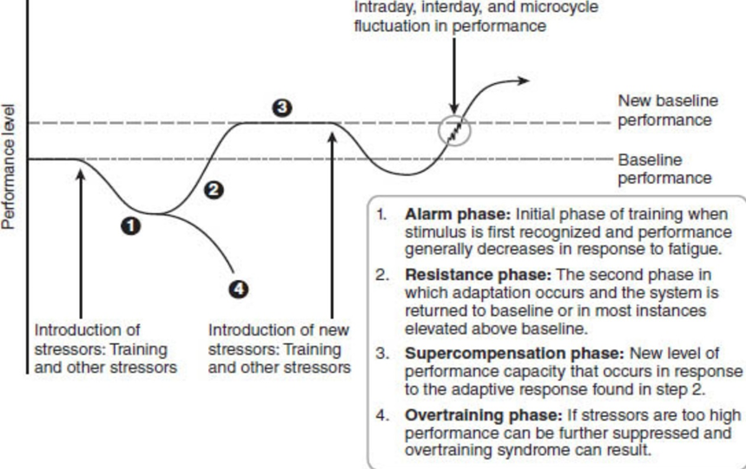
SUPERCOMPENSATION

Slide 20
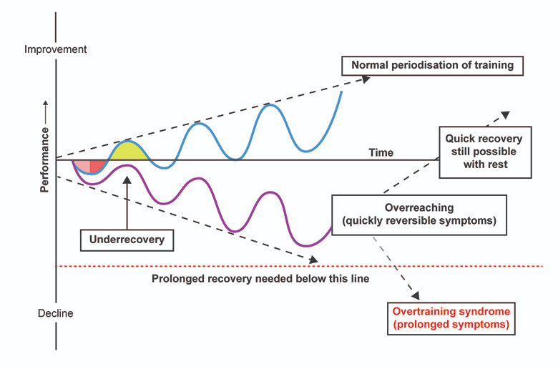
oVERTRAINING
Generally, training will induce fatigue that may take 24-48 hours (similar to DOMS)
In a balanced training programme, it is typical to plan for a progressive overload - recovery may take 1-2 weeks
However if overload is excessive alongside a poor programme, recovery is prolonged from weeks to months
As a result, the constant build up of stress from overload, combined with a poor programme (poor rest timings and lack of recovery) leads to non-functional overreaching (NFOR) OR overtraining syndrome (OTS)
Exercise addiction – athletes sometimes suffer from the euphoric feeling from training. Less focused on adaptations and more focused on the release of endorphins and dopamine

Slide 21
Imbalances in the endocrine system
↑ Resting cortisol levels (stress)
Cortisol suppresses the immune response – body is more susceptible to infection
Cortisol further ↑ due to repair and re-modelling response.
While cortisol ↑, so does growth hormone and lactate.
This ↓ the effectiveness of Testosterone, promoting muscle catabolism (protein breakdown) – if this persists, it may indicate OTS.

Slide 22
How does this impact the musculoskeletal system?
↑ SNS activity (Adrenaline & Noradrenaline) in early stages
Leads to poor sleep patterns - ↓ adequate rest and recovery from exercise
Inadequate recovery leads to tissue inflammation and further fatigue.
Incomplete repair and recovery of tissue before going into the next bout of exercise.
This leads to ↑ risk of injury and chronic muscle soreness - ↓ performance.

Slide 23
Endurance Adaptations
↑ capillary density
↑ haemaglobin & myoglobin?
↑ aerobic enzyme concentration
↑ red blood cell mass
↑ plasma volume
↑ cardiac output
↑ glycogen storage?
↑ fat burning capacity at a given exercise intensity
↑ capacity for evaporative heat loss [thermo-regulatory capillarization]
↑ mitochondrial size and number
↑arterial-venous O₂ difference
↑ventilation due to tidal volume and breathing frequency
↓ body fat percentage?
↓ sodium loss through sweating?
↓ Reduced systolic and diastolic blood pressure at rest and during sub-maximal exercise ?

Slide 24
Measurements of endurance
VO_{2max}
Exercise Ecomomy
Lactate Threshold
Ventilatory Threshold

Slide 25
Strength adaptations
  Increasing speed / power performance
  Injury prevention
  Muscular endurance
  Muscle hypertrophy
  Cross-Sectional Area (CSA)
    Strength is directly related to CSA
  Muscle fibre composition
    “fast” (type II) muscle fibres = greater force
  Connective tissue structure & muscle-tendon arrangement
    Transmission of force to lever (skeletal) system is modified by angle of tendon insertion

Slide 26
Resistance training
  Increased speed
  Increased jump height
  Increased endurance performance
  Increased “metabolic fitness”
  Decreased injury risk
  Decreased body fat
  Decreased falls in the elderly
  Decreased age-related bone and muscle loss

Slide 27
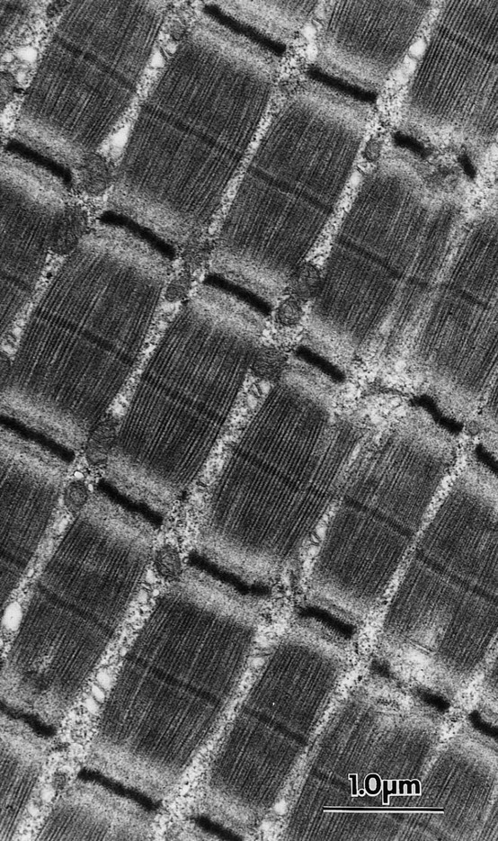
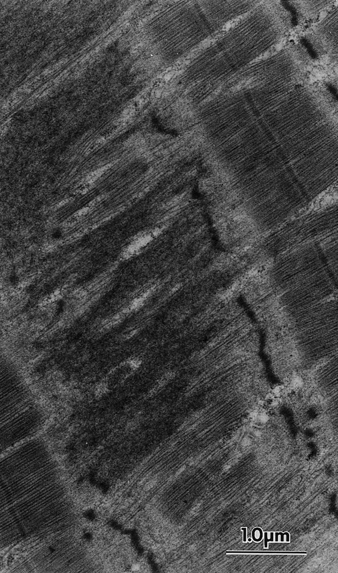
NO pain no GAIN?
Many trainees believe that DOMS (delayed onset muscle soreness) – a sign of muscle damage “microtrauma” is a requisite for strength and hypertrophy gains with RT
Normal appearance of muscle fibres
Fibres with exercise induced microtrauma

Slide 28

TRAINING INTERVENTION
Equal total work done during training between the groups
Muscle damage group indicated by 5 x higher levels of plasma levels of the enzyme creatine kinase (CK) and perceived muscle soreness
RESULTS
Muscle size and strength gains were not different for the two groups. Similar increases in levels of the growth factors
Significant increases in CSA - equal in both groups
Strength increases identical (NON DOMS=25% and DOMS=26% improvement)
CONCLUSION: Muscle rebuilding leading to hypertrophy and strength development can be achieved without evidence of muscle damage

Slide 29
proprioception training
Improved joint position sense
Improved joint stability
Decreased loading within a joint
Reduced risk of injury – faster responses to vulnerable positions
Improved fall strategies
Confidence
Reduced muscle compensation – muscles may become overactive if proprioception is decreased as they will compensation to stabilise the joint

Slide 30
‘An even distribution of weight enabling someone (or something) to remain upright and steady’ (Pollock et al., 2000)
BALANCE
VESTIBULAR
SYSTEM
OCULMOTOR
SYSTEM
SOMATIC SENSORY
RECEPTORS
MECHANO-
RECEPTORS
NOCICEPTORS
THERMORECEPTORS
‘The ability to sense stimuli arising within the body regarding position, motion and equilibrium’(Jones, 2000)
PROPRIOCEPTORS
PACINIAN
CORPUSCLES
GOLGI TENDON
ORGANS
MUSCLE
SPINDLES

Slide 31
PRO/REGRESSIONS
STATIC
DYNAMIC
STABLE SURFACE
UNSTABLE SURFACE
WIDE BASE
SMALL BASE
PRE-DETERMINED
PERTUBATIONS
EYES OPEN
EYES CLOSED
HEAD/EYES STILL
VARIATIONS IN HEAD/EYE MOVEMENT
UNIPLANE
MULTIPLANE

Slide 32
MECHANORECEPTORS
Ruffini endings
  Bulb-shaped receptors located in the epidermis
  Detect cold, heat and pressure
Pacinian corpuscles – FAST-CONDUCTING
  Bulb-shaped receptors located deep in the dermis
  Largest of the skin's receptors
  Believed to provide instant information about how and where we move

Slide 33
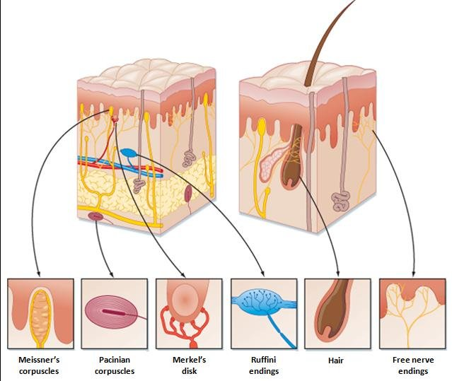
MECHANORECEPTORS

Slide 34
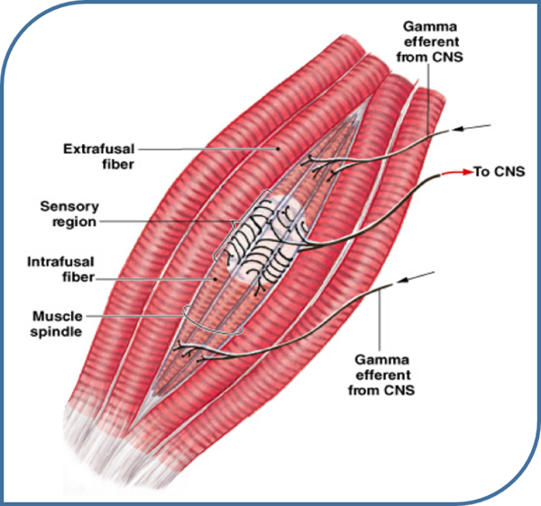
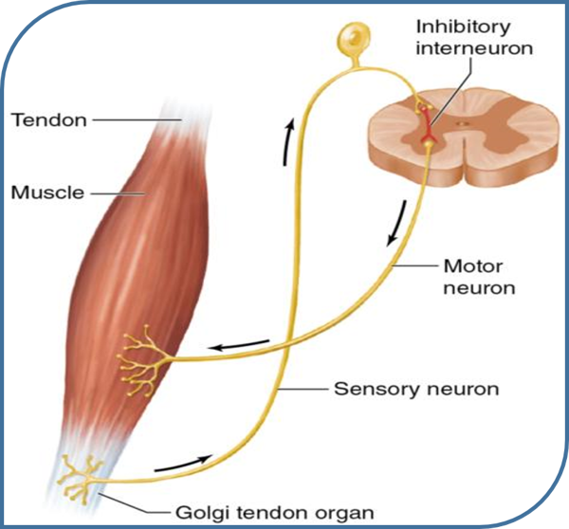
MUSCLE SPINDLES
GOLGI TENDON ORGANS
Detect the length of the muscle
Detect the rate of which length change is occurring
Detect the amount of tension in the muscle

Slide 35
Further Reading
Budgett, R., 1990. Overtraining syndrome. British journal of sports medicine, 24(4), pp.231-236.
Cunanan, A.J., DeWeese, B.H., Wagle, J.P., Carroll, K.M., Sausaman, R., Hornsby, W.G., Haff, G.G., Triplett, N.T., Pierce, K.C. and Stone, M.H., 2018. The general adaptation syndrome: a foundation for the concept of periodization. Sports Medicine, 48(4), pp.787-797.
Saltin, B. and Rowell, L.B., 1980, April. Functional adaptations to physical activity and inactivity. In Federation proceedings (Vol. 39, No. 5, pp. 1506-1513).
Uddin, N., Tallent, J. and Waldron, M., 2020. Physiological and perceptual responses to a five-week pre-event taper in professional mixed martial arts athletes. The Journal of Sport and Exercise Science, 4(2), pp.90-99.
Wallace, L.K., Slattery, K.M. and Coutts, A.J., 2009. The ecological validity and application of the session-RPE method for quantifying training loads in swimming. The Journal of Strength & Conditioning Research, 23(1), pp.33-38.

